Slide 1
UNIT-5
ALGORITHM DESIGN AND ANALYSIS

Slide 2
Contents
Algorithm Analysis
  Asymptotic Notations
Divide and Conquer
  Merge Sort
  Quick Sort
  Binary Search
Greedy Algorithms
  Knapsack Problem
Dynamic Programming
  Optimal Binary Search Tree

Slide 3
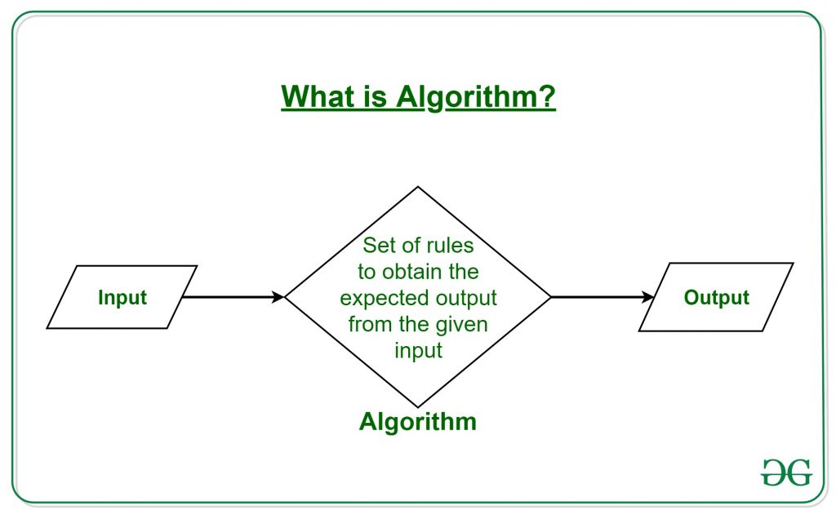
Algorithm
An algorithm is a set of instructions for solving a problem or accomplishing a task.
A set of steps to accomplish or complete a task that is described that computer can run it.
A process or a set of rules.

Slide 4
Algorithm
It is a finite set of instructions that accomplishes a specific task.
It is any special method of solving a certain kind of problem.
In computer science, algorithm is a precise method used by a computer for the solution of a problem.
It is not the complete program or code; it is just a solution (logic) of a problem
It is represented either as an informal description using a Flowchart or Pseudocode.

Slide 5
Algorithm Example
Design an algorithm to add two numbers and display the result.
Step 1 − START
Step 2 − declare three integers a, b & c
Step 3 − define values of a & b
Step 4 − add values of a & b
Step 5 − store output of a+b to c
Step 6 − print c
Step 7 − STOP

Slide 6
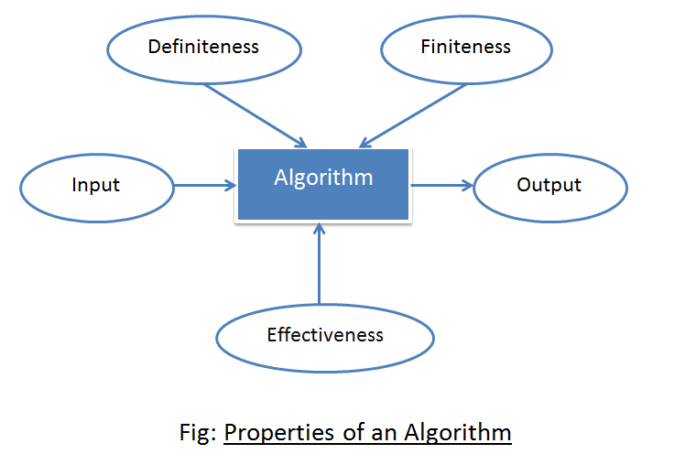
Characteristics of Algorithm
Characteristics of an algorithm:-
All algorithms must satisfy the following criteria:
  Input
  Output
  Definiteness
  Finiteness
  Effectiveness

Slide 7
Characteristics of Algorithm
  Input -Must take an input.
        -Zero or more quantities which are externally supplied.
  Output -Must give some output(yes/no, value etc.)
        -At least one quantity is produced.
  Definiteness -Each instruction is clear and unambiguous.
        -It must be perfectly clear what should be done.
  Finiteness -Algorithm terminates after a finite number of steps.
  Effectiveness -Every instruction must be basic i.e. simple instruction.
  -Done in a finite amount of time.

Slide 8
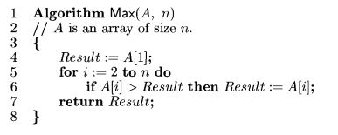
Algorithm Example
Algorithm finds and returns the maximum of n given numbers:

Slide 9
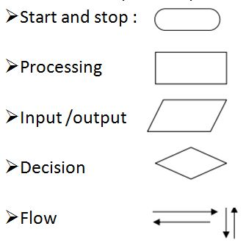
Flowchart and Algorithm
Flowchart : Graphical representation of an algorithm

Slide 10
Example
Problem:- Add two numbers entered by the user:
Algorithm: (Pseudo code)
Step 1: Start
Step 2: Declare three variables a, b, and sum.
Step 3: Enter the values of a and b.
Step 4: Add the values of a and b and store the result in the sum variable, i.e., sum= a+ b.
Step 5: Print sum
Step 6: Stop

Slide 11
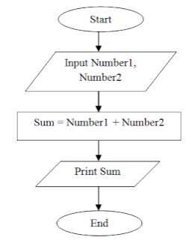
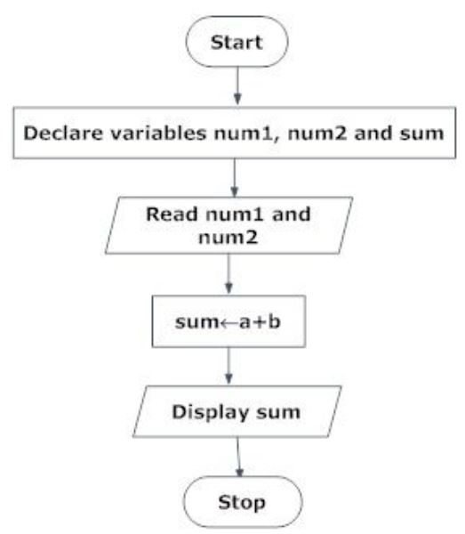
Flowchart

Slide 12
Example
Problem:- Write an algorithm whether person is eligible for voting based on age entered by user.
Algorithm:
Step 1: Start
Step 2: Declare the variable age
Step 3: Enter the value of age
Step 4: check whether age is greater than 18 or equal to 18
Step 5: if yes display “person is eligible for voting”
Step 6: else display “not eligible”
Step 6: Stop

Slide 13
Algorithm Analysis
    -When an algorithm is executed,
    - it makes use of the computer's CPU to perform operations and
    - it uses the memory to hold the program and its data.
    -Analysis of algorithms
    -Process of determining how much computing time and storage an algorithm will require is called as Algorithm Analysis.

Slide 14
Algorithm Performance Analysis
Evaluate the performance of an algorithm in terms of input size
  (no actual running time).
Calculate how the time/space taken by algorithm increases with input size.
Complexity is important aspect in designing of algorithm.
Complexity analysis is concerned about its performance,
how fast or slow it works.
Complexity of an algorithm
  It describes the efficiency of the algorithm in terms of
    the amount of the memory required to process the data and
    the processing time.

Slide 15
Algorithm Performance Analysis
Performance analysis of algorithm is concerned with:
    Computing time-Time Complexity
    Storage requirement-Space Complexity
Time and space complexity depends on lots of things like hardware, operating system, processors, etc.
Time Complexity:
  It is the amount of computer time it needs to run to completion.
Space Complexity:
  It is the amount of memory it needs to run to completion.

Slide 16
Space Complexity
The space complexity of an algorithm is the amount of memory it needs to run to completion.
Storage needs for program and data to completion of task.
For an algorithm, the space is required for the following purposes:
    To store program instructions
    To store constant values
    To store variable values
    To track the function calls, jumping statements, etc.
Consider example: Sum of m for n times.
Two methods to solve it:
  1. Iterative method 2. Recursive method

Slide 17
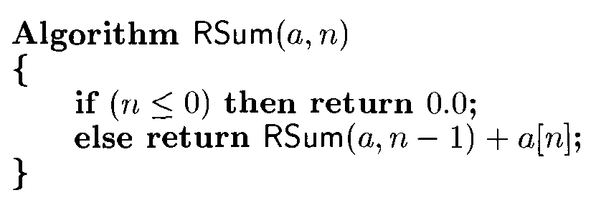
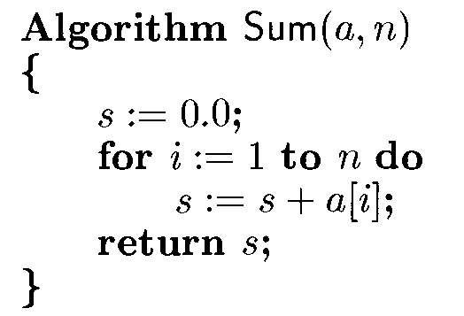
Space Complexity examples
Iterative function for sum Recursive function for sum

Slide 18
Space Complexity examples
Recursive function for Division
Algorithm RDiv(a, n)
{
if(n<=0) then
return 0;
else
return RDiv(a-n, n)+1
}
n=5, a=2
Rsum(a, n-1)+a
Rsum(2,4)+2
Rsum(2,3)+2+2
Rsum(2,2)+2+2+2
Rsum(2,1)+2+2+2+2
Rsum(2,0)+2+2+2+2+2

Slide 19
Space needed by algorithm
Iterative function for sum Recursive function for sum

Slide 20
Time Complexity
  The time complexity of an algorithm is the amount of computer time it needs to run to completion.
  It’s a function describing amount of time required to run an algorithm.
  The Time T(P) taken by a program P is the sum of compile time and run(execution) time.
  Compiled program will be run several times without recompilation.
  This run time is denoted by tp (instant characteristics).
  Time T(P) is given by number of steps taken by algorithm to compute function it was written for.

Slide 21
Time Complexity
A Program Step
    It is defined as a syntactically or semantically meaning segment of a program
    that has an execution time.
    that is independent of the instance characteristics.
"Time" can mean
  the number of memory accesses performed,
  the number of comparisons between integers,
  the number of times some inner loop is executed.
Example-

Slide 22
Step count for Time complexity
Two ways to determine number of steps needed by program:
1. To introduce new variable count into program.
  It is global variable with initial value 0.
  Count is incremented by the step count of that statement.
2. To build a table with list of total number of steps contributed
by each statement.
  First determine number of steps per execution (s/e) of the statement.
  Total number of times ( frequency) each statement is executed.

Slide 23
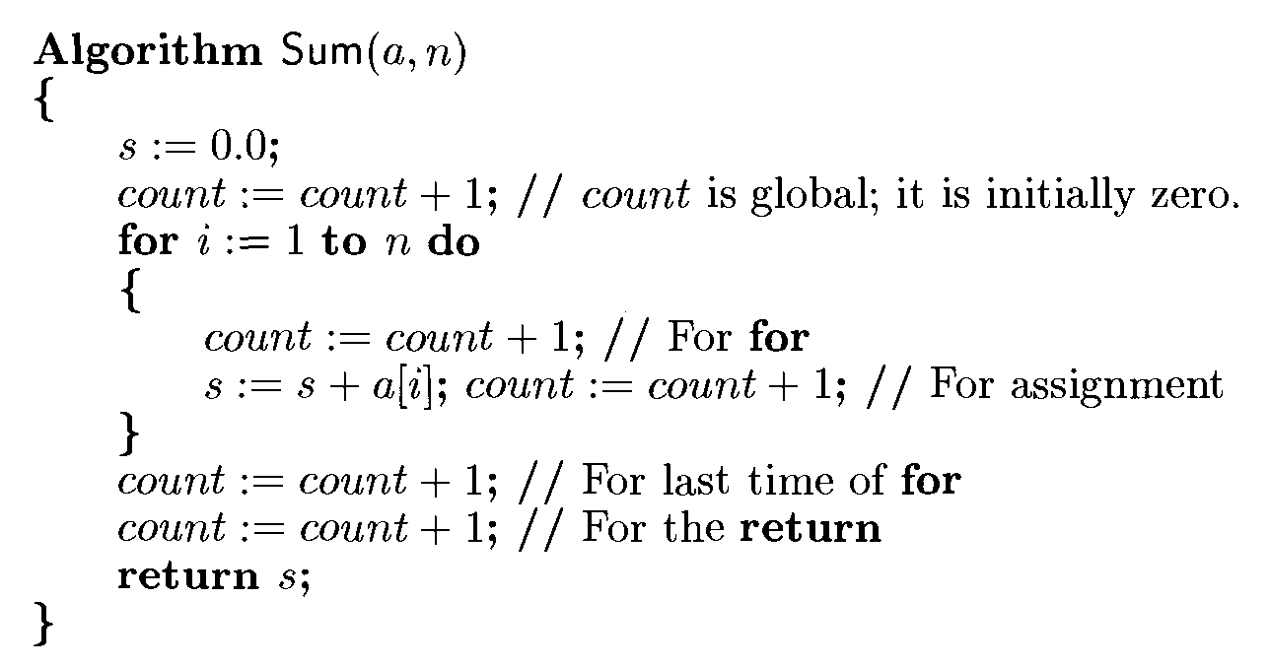
1. To introduce new variable count into program.
Step count for Iterative algorithm Sum(a,n)

Slide 24
1. To introduce new variable count into program.
Step count for Iterative algorithm Sum(a,n)
Algorithm Sum(a,n) executes total of 2n+3 steps
For for loop count will be increase by total of 2n steps.

Slide 25
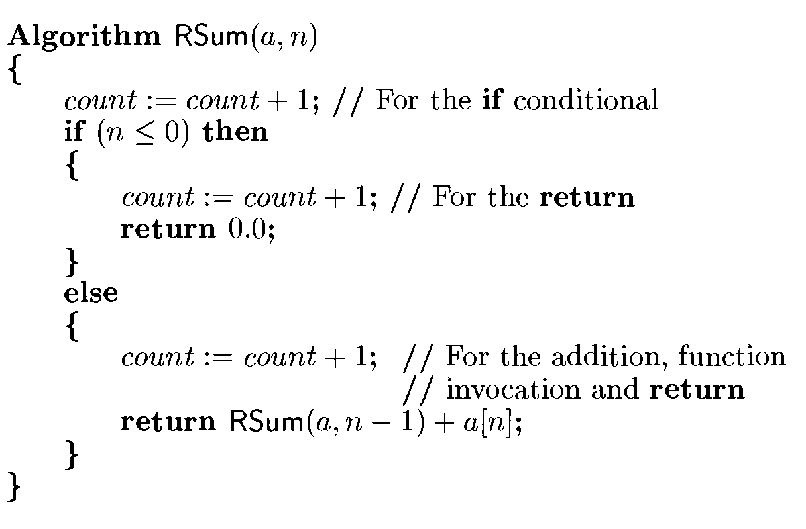
Step count for Recursive Algorithm Rsum(a,n)

Slide 26
Step count for Recursive Algorithm Rsum(a,n)
In recursive algorithm, tRSum(n) be the increase in the value of count.
If tRSum(0), then count increases by 2.
If tRSum(n), when n>2, then count increases by 2 plus whatever increase results from the invocation of RSum from within the else clause.
Additional increase in count is tRSum(n-1).
Count value at the time of termination is 2+tRSum(n-1), when n>0

Slide 27
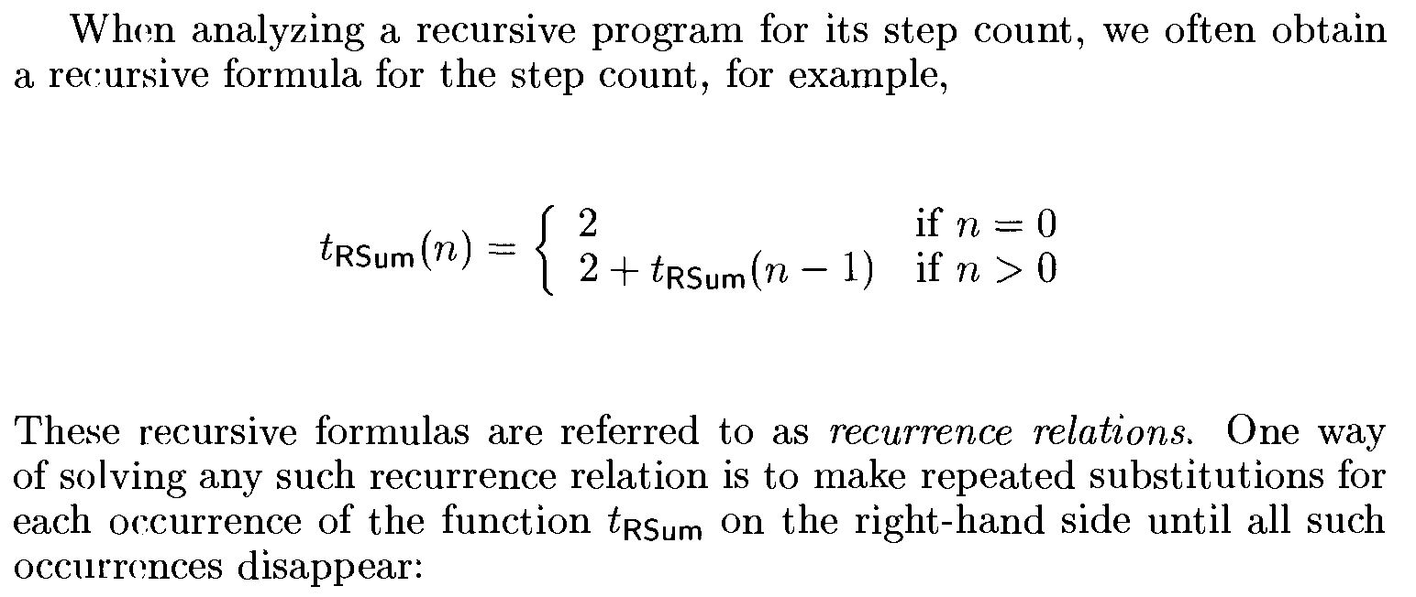
Step count for Recursive Algorithm Rsum(a,n)

Slide 28
2. To build a table with list of total number of steps contributed
To build a table with list of total number of steps contributed
by each statement.
  First determine number of steps per execution (s/e) of the statement.
  Total number of times ( frequency) each statement is executed.

Slide 29
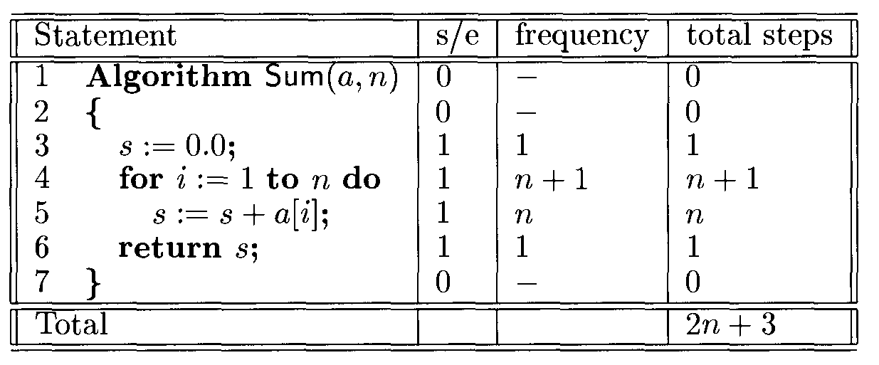
Step count table for Iterative Algorithm Sum(a,n)

Slide 30
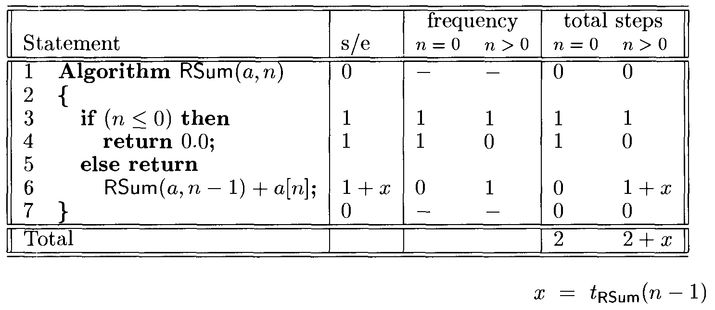
Step count table for Recursive Algorithm Rsum(a,n)

Slide 31
Kinds of step count
To determine step count uniquely by defining three kinds of step count:
Best case-
  It is minimum number of steps that can be executed for the given parameters.
Worst case-
  It is maximum number of steps that can be executed for given parameters.
Average case –
  It is average number of steps executed on instances with given parameters.

Slide 32
Asymptotic Notations
Execution time of an algorithm depends on the instruction set,
processor speed, disk I/O speed, etc.
Time function of an algorithm is represented by T(n).
Asymptotic notations are used
      To estimate the efficiency of an algorithm.
      To represent the complexity of an algorithm.
      To calculate the running time complexity of an algorithm.
Asymptotic notations are:
  O − Big Oh
  Ω − Big omega
  θ − Big theta

Slide 33
O-Big “oh”
Big-oh is formal method of expressing the upper bound of algorithm's
running time.
It is the measure of the longest amount of time of algorithm running.
The function f(n)=O(g(n))
iff there exist positive constants c and n0 such that
f(n)<=c*g(n) for all n, where n>=n0.
Note- F(n)=O(g(n))→read as “f of n is big oh of g of n”.
Function g (n) is an upper bound for function f (n), as g(n) grows faster
than f (n)

Slide 34
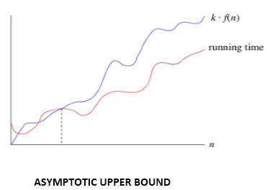
O-Big “oh” Notation
The Big-O defines an upper bound of an algorithm which ensures that the function never grows faster than the upper bound.
It express the upper boundary of an algorithm’s running time.
It represents maximum amount of time an algorithm can take to run.
It represents/measures the worst case of time complexity

Slide 35

O-Big “oh”
Example-

Slide 36
O-Big “oh” Example
Solution:: Big O is:
f(n) ≤ c . g(n) f(n) = O(n)
|f(n)| ≤ c . |g(n)| g(n) = n
So, 3n+2 ≤ c.n
Let C=4, n=1 3*1 + 2 ≤ 4*1 5 ≤ 4 false
C=4, n=2 3*2 + 2 ≤ 4*2 8 ≤ 8 True
C=4, n=3 3*3 + 2 ≤ 4*3 11 ≤ 12 True
C=4, n=4 3*4 + 2 ≤ 4*4 14 ≤ 16 True
C=4, n=5 3*5 + 2 ≤ 4*5 17 ≤ 20 True

Slide 37
O-Big “oh” Example
Solution: Big O is:
f(n) ≤ c . g(n)
So, f(n) = 3n+2 ≤ c . n
3n+2 = O(n)
F(n) = O(n)

Slide 38
O-Big “oh” Example
F(n) = 3n+2, prove that f(n)= O(n²)
Solution:: Big O is:
f(n) ≤ c . g(n) f(n) = O(n²)
|f(n)| ≤ c . |g(n)| g(n) = n²
So, 3n+2 ≤ c. n²
Let C=1, n=1 3*1 + 2 ≤ 1* 1² 5 ≤ 1 false
C=1, n=2 3*2 + 2 ≤ 1* 2² 8 ≤ 4 False
C=1, n=3 3*3 + 2 ≤ 1* 3² 11 ≤ 9 False
C=1, n=4 3*4 + 2 ≤ 1* 4² 14 ≤ 16 True
C=1, n=5 3*5 + 2 ≤ 1* 5² 17 ≤ 25 True
C=1, n=6 3*6 + 2 ≤ 1* 6² 17 ≤ 36 True

Slide 39
O-Big “oh” Example
Solution: Big O is:
f(n) ≤ c . g(n)
So, c=1, n=4
f(n) = 3n+2 ≤ c . n²
3n+2 = O(n²)
F(n) = O(n²)

Slide 40









O-Big oh complexity
means computing time is a constant.
called linear
called quadratic
called cubic
called exponential
called it is faster, for sufficiently large n.
is better than , but not as good as

Slide 41
  Omega- Ω
Omega expresses the lower bound of algorithm's running time.
It is the measure of the smallest amount of time of algorithm running.
Ω notation provides an asymptotic lower bound.
Ω Notation provides lower bound on time complexity of an algorithm.
It represent minimum amount of time an algorithm can take to run.
It represents Best-case complexity.

Slide 42
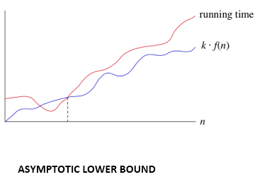
  Omega- Ω Notation
Measures the best amount of time an algorithm can possibly take to
complete.
Determines what is the fastest time that an algorithm can run.

Slide 43
Theta (Θ) Notation
θ Notation is more precise than both the big-oh and Omega notation.
The function f (n) = θ (g (n)) if g(n) is both an upper and lower bound.
It describes upper and lower bound of the running time of an algorithm.
It is used for analyzing the average-case complexity of an algorithm

Slide 44
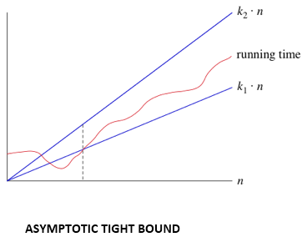
Theta (Θ) Notation

Slide 45
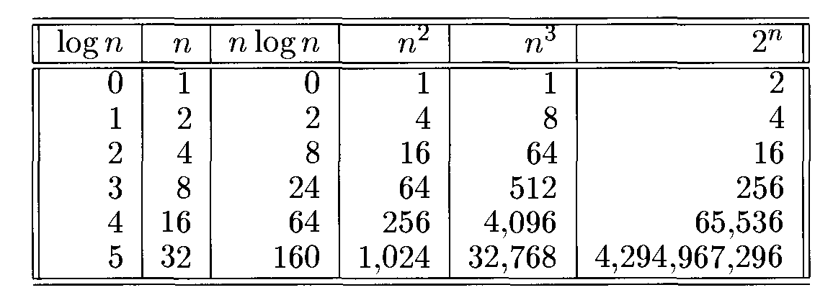
Function values
log n <n <n log n< n^2 < n^3 < 2^n

Slide 46
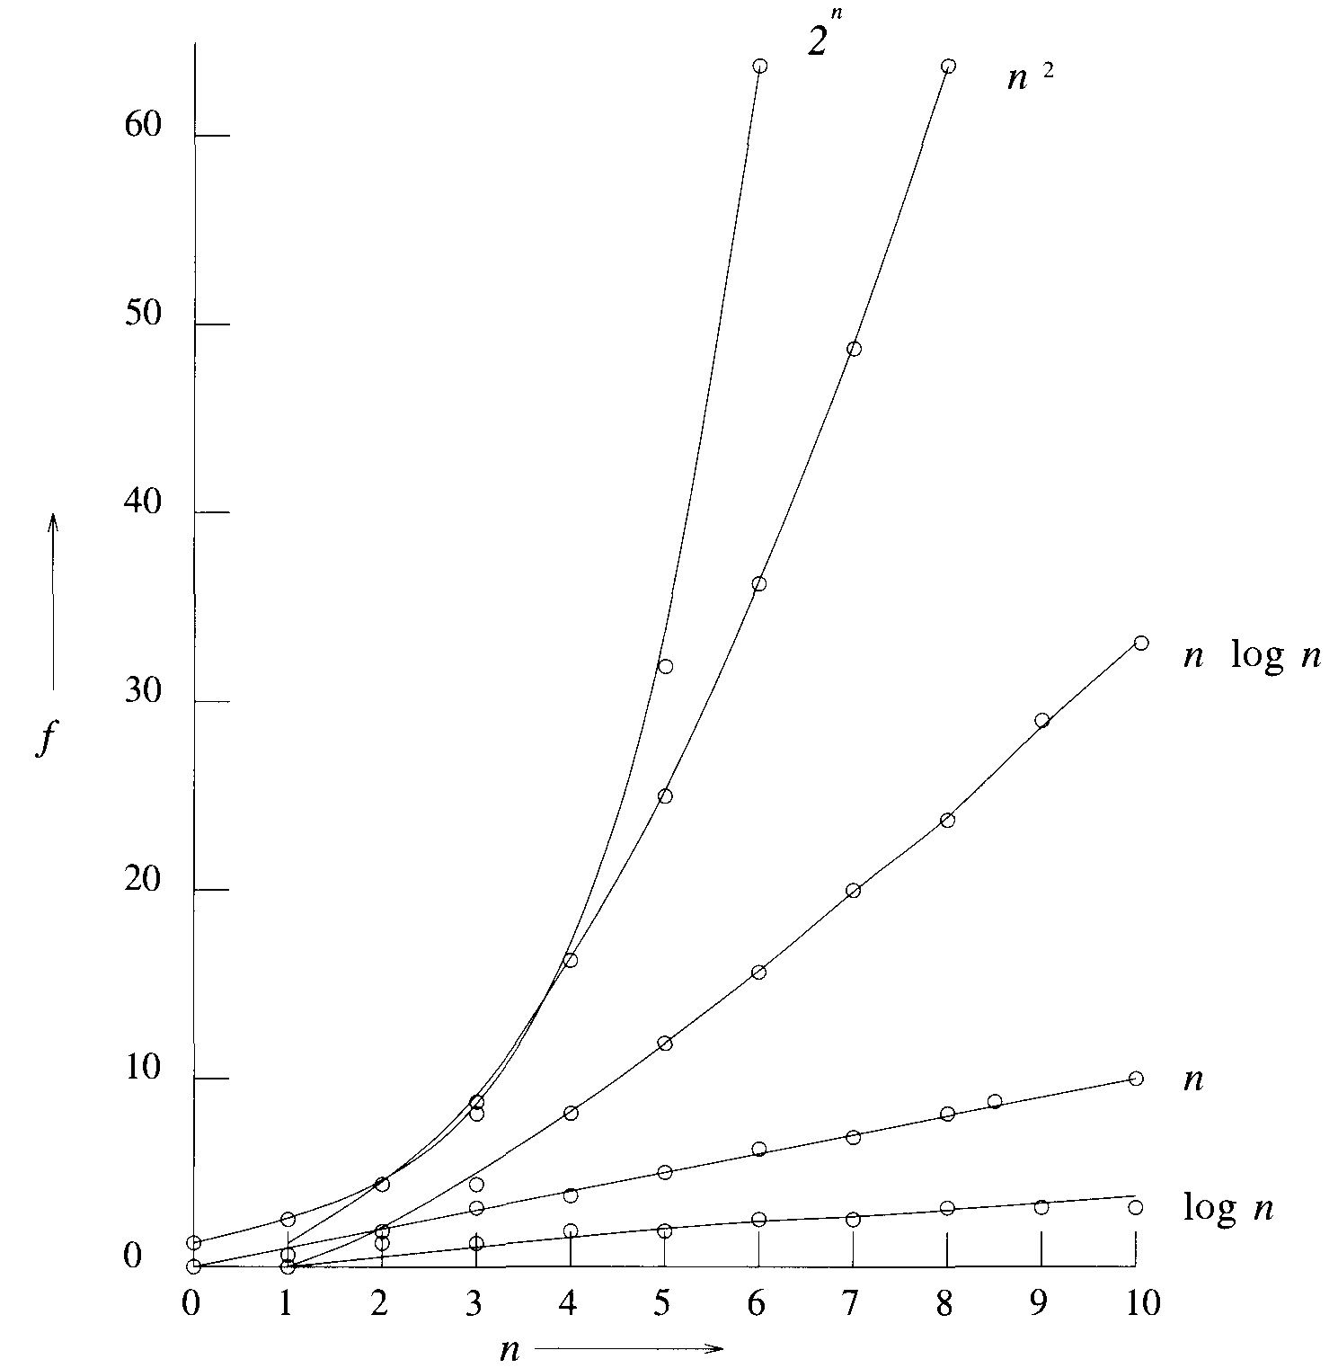
Plot a graph of function value

